Slide 1


Introduction to ML and data handling
Spoorthi U K
6th semester
Electronics and communication
PESU EC

Slide 2
Agenda
Introduction
ML Project cycle
Data handling
Data visualization
Model building and evaluation

Slide 3
What is Machine Learning?
Programs with the ability to learn and reason like humans
Artificial Intelligence
Algorithms with the ability to learn without being explicitly programmed
Machine Learning
Artificial neural networks that adapt and learn from huge amount of data
Deep Learning

Slide 4
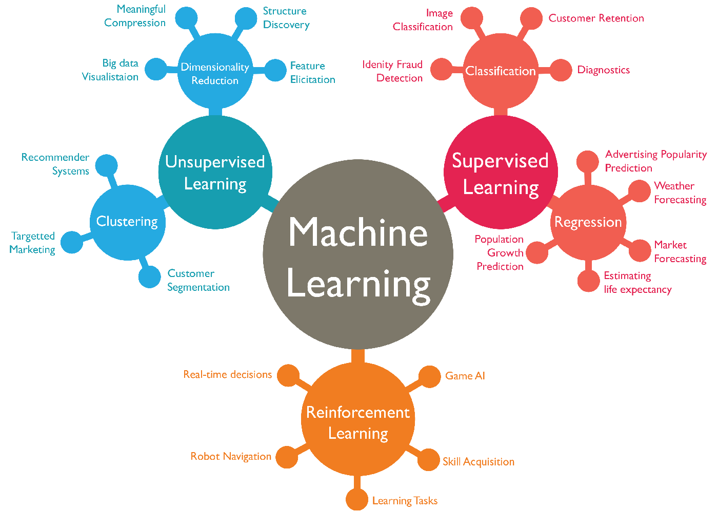
Classification

Slide 5
ML project cycle
Data Pre-processing
Understanding Problem Statement
Data Collection
Data Analysis
Data Visualization
Feature Engineering
Prediction
Model Evaluation
Model training
Build a model

Slide 6
Thank You
<
<
)

